Slide 1
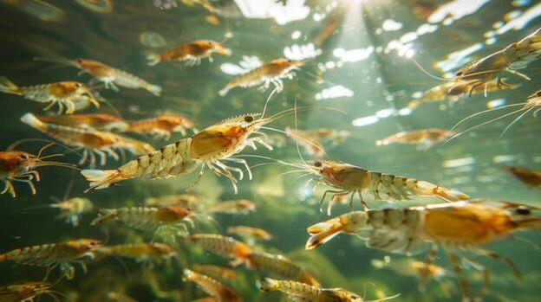
AQUAGUARD – Aquaculture Smart Monitoring System

Slide 2
Project Title:
Aqua Guard – IoT Based Water Quality Monitoring for Shrimp Farming.
Scenario:
Monitor water quality parameters in shrimp ponds and trigger alerts when conditions become unsafe.

Slide 3
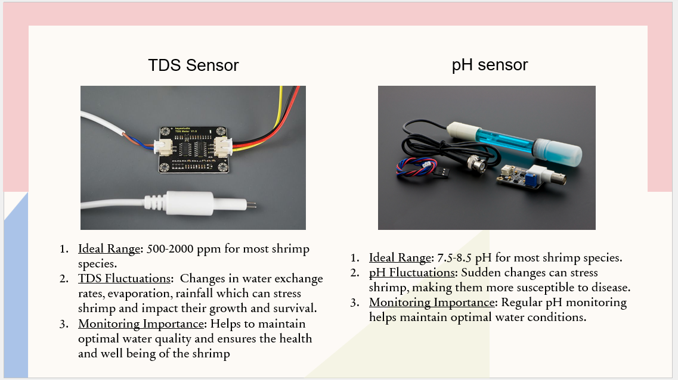
Sensors List:

Slide 4
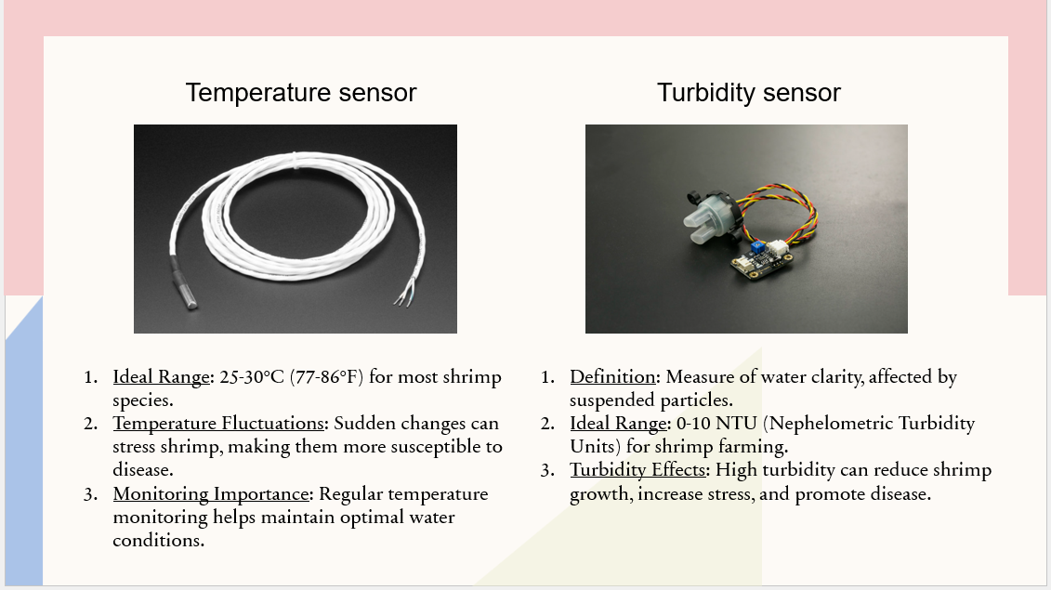

Slide 5
Sensor Selection List
Sensor | Parameter Monitored | Reason
pH Sensor | Acidity/Alkalinity | Shrimp require stable pH (7.5 – 8.5) for healthy growth
Temperature Sensor | Water Temperature | Impacts shrimp metabolism and dissolved oxygen
TDS Sensor | Total Dissolved Solids | Indicated salinity and mineral concentration
Turbidity Sensor | Water Quality | High turbidity indicates waste buildup and poor quality
Justification
These sensors monitor the most critical environmental conditions that affect shrimp survival, growth rate, and disease prevention. Continuous monitoring helps farmers take preventive action before water conditions become harmful.

Slide 6
Data Flow
Overview
Step 1 – Sensor Layer
Water quality sensors placed inside the shrimp pond continuously measure: pH level, Temperature, TDS (salinity level), Turbidity (water clarity)
These sensors provide analog signals to the ESP32.
Step 2 – Gateway Layer (ESP32)
The ESP32 microcontroller acts as an IoT Gateway.
Functions performed:
• Reads sensor values using ADC pins
• Converts raw readings into real-world units
• Performs basic validation of data
• Connects to Wi-Fi network & Sends data to cloud feeds
Step 3 – Cloud Layer (Adafruit IO)
Each sensor has a dedicated feed
Adafruit IO stores data and displays it on a dashboard with graphs and gauges
Sensors
ESP32(Gateway)
Adafruit IO Cloud
IFTTT Alerts
Alert Notification To Farmer

Slide 7
Alert Logic
Working
Parameter | Safe Range | Alert Condition
pH | 7.5 – 8.5 | If Outside Range
Temperature | 26 – 32 °C | If Outside Range
TDS | 300-800 ppm | If Outside Range
Turbidity | <20 NTU | If Above Range
ESP32 sends sensor data to Adafruit IO
IFTTT monitors Adafruit IO feeds
When a value crosses a threshold: IFTTT sends mobile notification / email
Farmer receives real-time alert to take corrective action

Slide 8
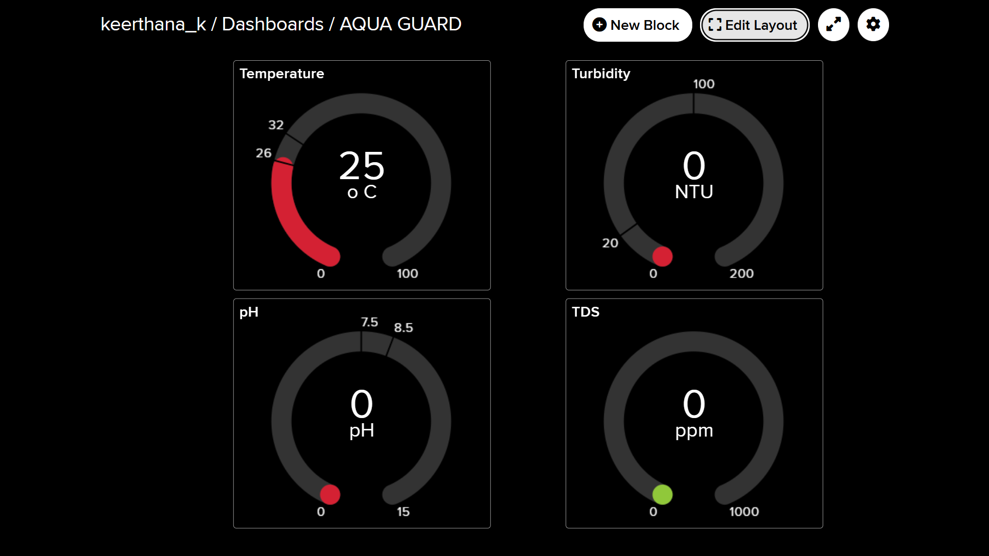
Cloud Dashboard

Slide 9
Sample JSON Output
{
"device_id": "AquaGuard_01",
"temperature": 29.6,
"ph": 7.9,
"tds": 520,
"turbidity": 14,
"status": "SAFE"
}
{
"device_id": "AquaGuard_01",
"temperature": 33.2,
"ph": 6.9,
"tds": 920,
"turbidity": 26,
"status": "ALERT"
}

Slide 10
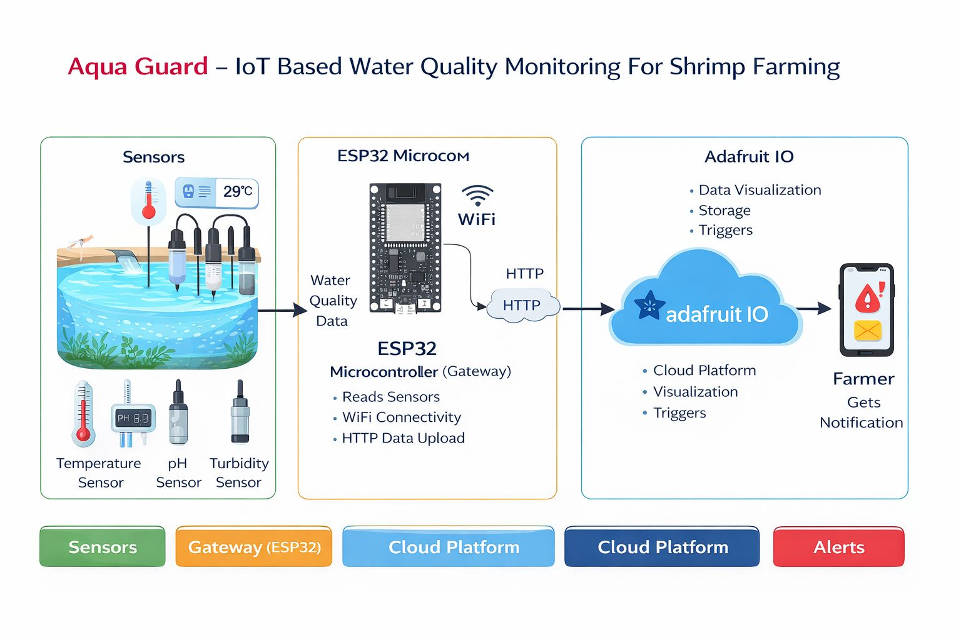
System Architecture

Slide 11
System Architecture Overview:
The Aqua Guard system consists of three main layers:
Sensor Layer – Collects real-time water parameters
Gateway Layer – ESP32 microcontroller for processing and Wi-Fi Communication.
Cloud Layer – Adafruit IO stores and visualizes data
Alert Layer – IFTTT sends notifications to farmers

Slide 12


